Slide 1


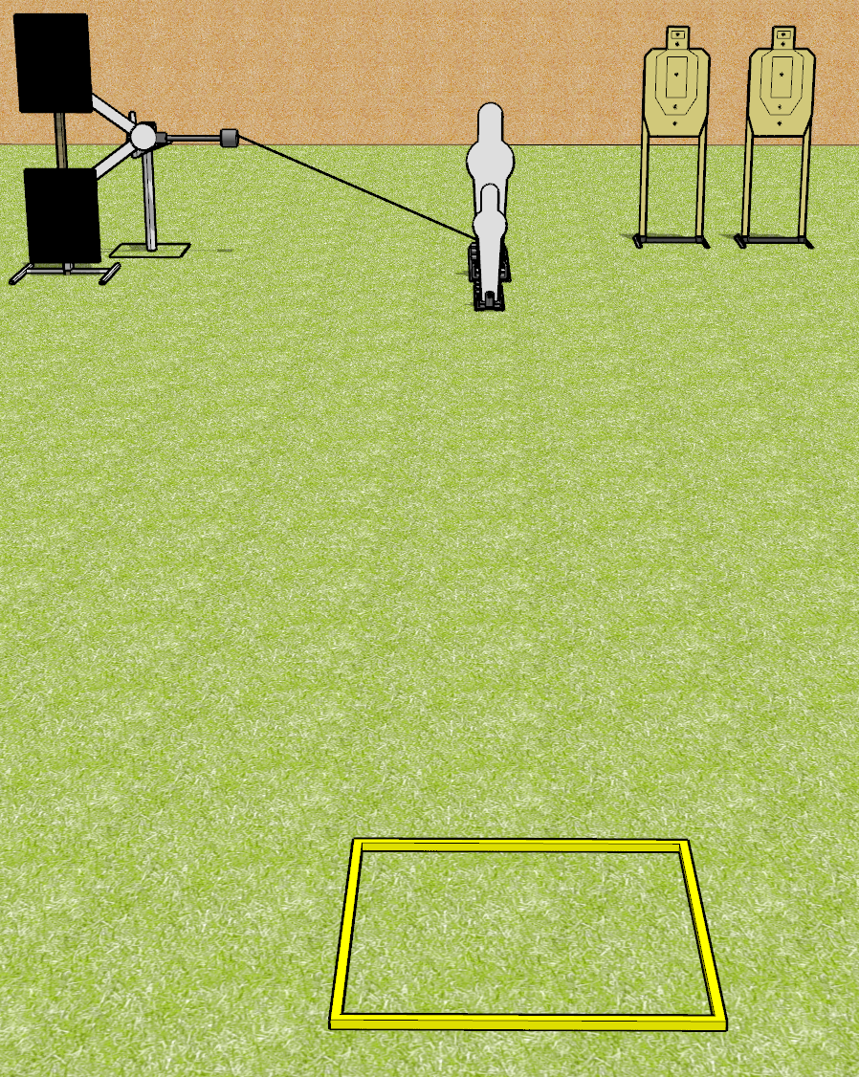
 | Dothan Gun Club – USPSA Match 4 and 4 Course Designer : Drew Coleman
Round Count 14 rounds 3 USPSA 1 pepper popper, 1 mini popper
Equipment List Red stitch swinger + activator Shooting box

Slide 2
4 and 4
Written Stage Briefing
4 and 4 is a 12 round, 60 point, Comstock speed shoot. The best 4 hits on paper will score, and steel must fall to score. The start signal is audible.
The swinger is activated by the pepper popper, and remains visible at rest.
Handgun start position is inside shooting area with fingers touching ears or ear pro. Handgun is loaded and holstered.
PCC start position is inside shooting area, stock on belt. Loaded carbine is held with both hands, safety on.
On start signal, engage paper targets with 2 rounds each, perform a mandatory reload, and engage with 2 rounds each. Steel may be engaged at any time in any order.

